Slide 1

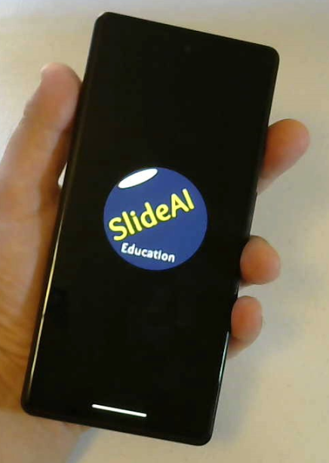

Business Plan for AI Education & Research
SlideAI Education Inc.

Slide 2


Easy AI Learning on Mobile
Maximized
Convenience
Product Demo

Slide 3







Two Minute Animation
6 Languages

Slide 4
Motivation of Starting Business
● Based on teaching experience in university
- Well-summarized & visual documents facilitate students to understand content.
- Students prefer asynchronous teaching / learning
- Visualized contents, videos attract students in learning.
● Based on experience
- There is lack of time for gathering information on Machine Learning fields.
- There’s need for better communication among researchers

Slide 5
Business Items
● Goal : Provide customers all round the world with slides, animations on AI
● Effects : 1. Provide students with learning opportunity on AI with affordable price.
2. Provide continuing education for reemployment
3. Facilitate research by providing recent tech & industry trends
● Content in AI Education / AI Research / News
● Boost Machine Learning research

Slide 6




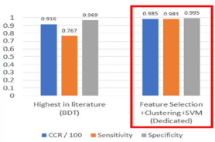

Web-base Interface Launching Plan
Mobile
Web-base UI
Web-base UI
Web-base UI
E-book/
Animation
E-book/
Animation
Coding
Education
Trial Edition
of Software
AI Education
AI Research
AI Education
AI Research
Practicing Machine Learning algorithms
BFS-CDSVM
Higher Accuracy
Lower Complexity
By Feb.
June
September
December
2023
2023
2023
2023

Slide 7
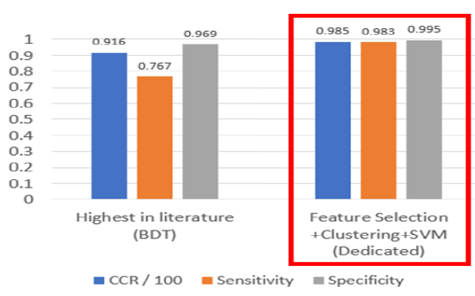
Developed AI Technology
https://github.com/Brandonlee01
BFS-CDSVM
Pathologic state of Unborn baby health can be detected with 98.3 %
AI technology for multiclass data
Can be applied to all scientific fields.
Brandonlee01/Fetal-Health-Prediction: PhD Dissertation research project, SSIE, Binghamton university (github.com)

Slide 8
Contents

Slide 9
SlideAI
Education
Education
Research
Contents
Contents

Slide 10
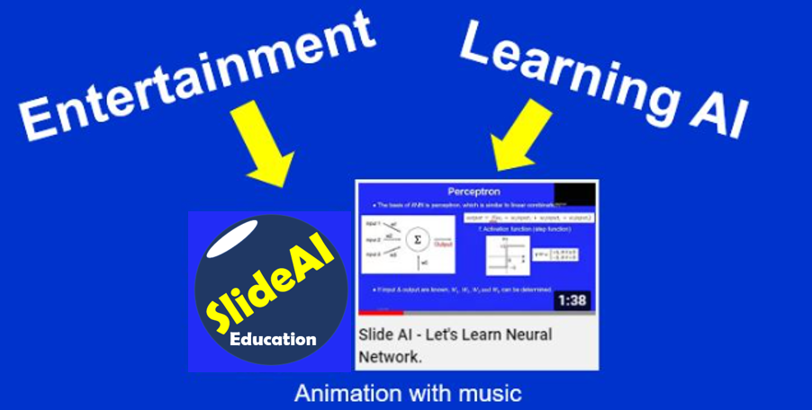
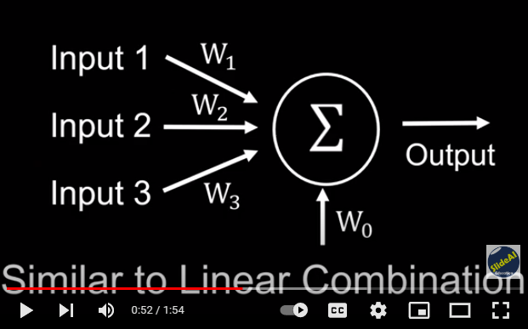
SlideAI Create New Genre

Slide 11
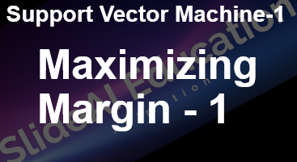
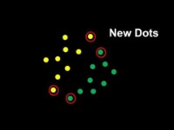
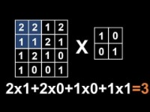

Animations (Samples)

Slide 12
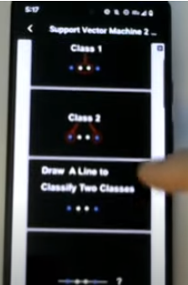

Slide Format e-book

Slide 13
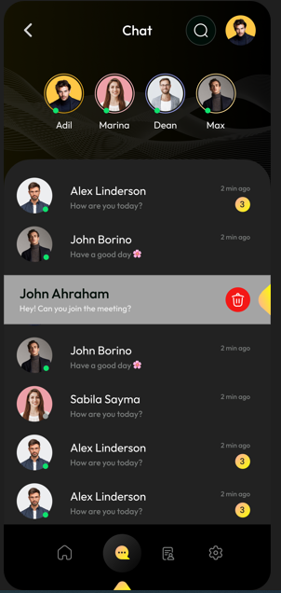
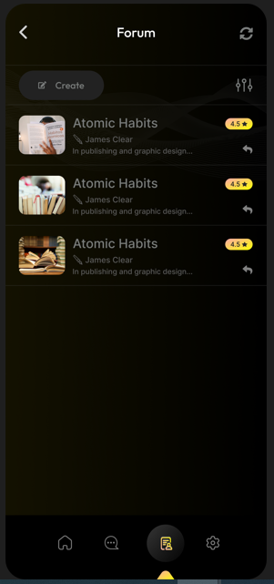
Chatting API & Forum
● Between Users
1. Users can chat each other.
2. Users can find friends &
recommend to friends.
● Between User & Admin
1. User can ask questions.
2. Admin reply as soon as possible.

Slide 14
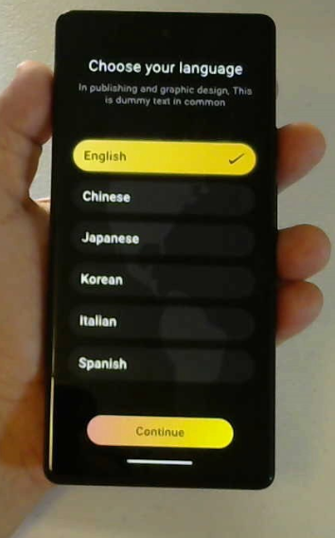

● Mobile App Developer
Indian Company
● Development Cost
: $10,800 spent
● Final step: Approval
from Google Play &
Apple Store
● Scheduled to launch by
the end of Feb. 2023

Slide 15

Currently in Approval Progress
Platforms
By February 2023 :
Mobile App Launch to Public

Slide 16


Competitor Analysis
● Differences compared to Coursera
1. Focus on User Convenience. (Easy-to-read Slide format, Animations)
2. Accessibility from All Generations. (Not Only University students)
3. Affordable Price (US$10 vs. $50~60)
● Differences compared to Udemy
1. Focus on Artificial Intelligence
2. Focus on User Convenience. (Animations)

Slide 17
Marketing Strategies
● All marketing will be implemented by advertising tools in Social Media
● Example : YouTube Ad, Facebook Ad

Slide 18
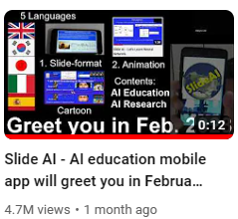


YouTube Ad
Facebook Ad
● YouTube channel
for advertising & demo videos.
https://www.youtube.com/channel/UCq3BevsNIobx468R9GZMQVg
This Ad Records 4.7M Views
● Effective Ad tool for all territories of Google Ad
● Maintain Ad experience (Sept. ~ Dec. 2022)
for brand recognition (spent $ 6,000)
● Plan to Use additionally.

Slide 19

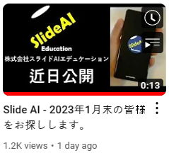
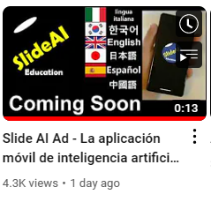
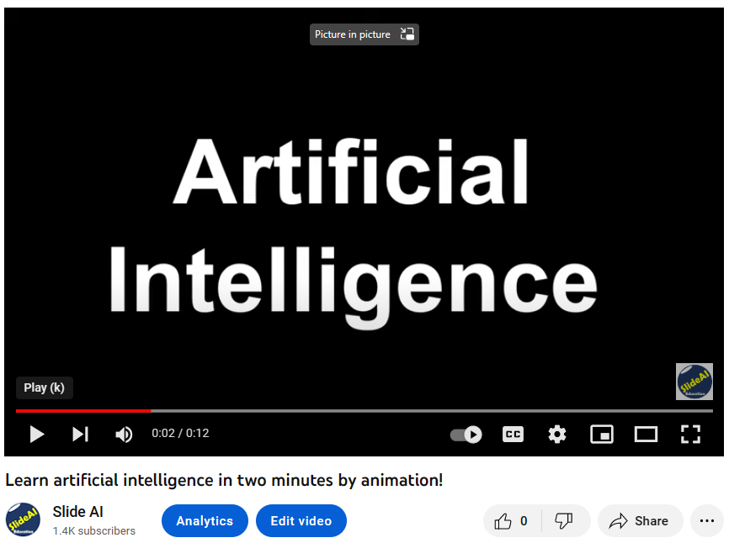
Customized Marketing in Progress
English
Japanese
Spanish
In 6 Languages

Slide 20
Target Users
● Providing Lecture Slides / Videos for two groups
For Self-learners
● 1st Step: In-depth understanding on ML.
- All ML algorithms
- Basic Statistic & Probability knowledge
● 2nd Step: Basic Coding
- Desktop User Interface will be
developed in 2024.
For Researchers
● Introduction to Recent trends
● Visual documents
- Easy explanation
- Facilitate R&D

Slide 21
Organizational Plan
Global Network Plan
Annual Goals in 2023 & 2024

Slide 22

Horizontal Structure
Head office (1)
Reginal offices (9)
San Jose, CA
(or Seattle, WA)
(AI Research Center)
Marketing /
Customer Satisfaction
Tokyo
●
Seoul
Media / Translation
Toronto
●
CEO/CTO/HR
●
●
●
Singapore
New York
●
Contents
Development
London
Barcelona
●
Education / Research
Rome
●
●
Wilmington, DE

Slide 23
Global Network Plan & Annual Goal, 2023
Target Revenue:
$ 43 M
Recruitment
San Jose, CA
Launching Mobile App
2 Reginal Managers
(Silicon Valley, Seoul)
●
Seoul
●
Minimize Labor cost
Headquarter:
Delaware
●
Series A Investment
Content Development
Accumulate Marketing Tech
Patent Registration
Publishing to Journals
(BFS-CDSVM)
100 % Remote Work
Maximize Marketing Capability

Slide 24
Global Network Plan & Annual Goal, 2024
Target Revenue:
$ 80 M
San Jose, CA
(AI research center)
Tokyo
Learning Technology
Media Technology
Fetal Health Prediction
Medical Device Development
Lightweight AI tech
●
Seoul
Delaware
●
Recruitment Plan
●
Toronto
●
●
●
New York
●
2 Software Engineers
Singapore
London
Barcelona
2 AI Researchers
●
Rome
●
●
2 Medical Advisors
1 CEO/CFO, 1 CTO, 1 CMO & 7 Reginal Managers (Japanese, Chinese, Spanish, Italian)

Slide 25
Long-Term Plan

Slide 26


Plan for AI Research Center
5 Main Technologies to Develop
SlideAI Education Inc.
(Parent Company)
AI Research Center
(Subsidiary)
Avoid Risk on Investment
Learning Technology
Media Technology
Unborn baby Health Prediction
Medical Device Development
Lightweight AI technology

Slide 27
Plan for Applying Technology
(BFS-CDSVM)
Projected timeline
Phase 1:
Applying to Marketing data for platforms (Youtube) Ad
~2023
Phase 2:
Developing it to complete Software
~2024
Establishing Research center
Phase 3:
Applying to Unborn baby health checking device.
2025~2026
Phase 4:
Applying to Other medical devices using multiclass data.
2026~2027
Target timeline for Initial Public Offering (NASDAQ)
2028

Slide 28
Revenue Estimation

Slide 29





Population of Major Language Users
2.3 Bil
To be published in 6 Languages
1.3 Bil
Chinese
460 Mil
128 Mil
Additional languages can be added after launch
63 Mil
52 Mil
4.3 Bil (54% of World Population)

Slide 30
Revenue Estimation in 2023
Target User : 0.01% of 6 Language Population : 430,000
Monthly subscription fee : $10
Subscription Period : 10 months (March ~ Dec. 2023)
Revenue : $ 43 M
Profit : $ 21 M

Slide 31
Investment Plan

Slide 32
Long-Term Business Plan
Series A
(Series B)
If Required
AI Education
(Series C)
AI Research
If Required
Expansion
Global Network
M & A
IPO
Target Timeline: 2028
Stage
1st
2nd
3rd

Slide 33
Requesting Series A Investment
Amount: $ 1 Million
Cost items (2023)
: Mobile Platform fee ( Google Play, App Store, 30%)
: Customized ad for local countries.
: Labor cost (3), Additional (Web base UI) Interface cost
: Accounting fee, Patent registration fee.
Profit in 2023 will be invested to Research in 2024.

Slide 34
Company & People

Slide 35
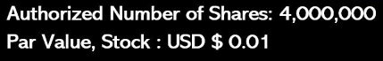
Slide AI Education Inc.
● AI Company for AI Education & Research
● Global Company targeting global market
● Founded in Delaware State, USA (Nov.2022)
SlideAI
Education

Slide 36
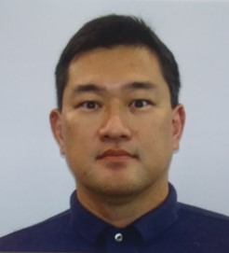

Brandon Jinpyo Lee
● CEO, SlideAI Education Inc.
● Instructor & Professor, Computer Science
Auburn University at Montgomery (~ Dec. 2022)
● AI Scientist & Author of Machine Learning books
● State University of New York, Binghamton
(Ph.D. Systems Science, 2019)
● University of Michigan (MSE, Industrial Eng., 2011)
● Seoul National University (BSE, Naval Architecture, 2003)
● U.S. Permanent Resident

Slide 37

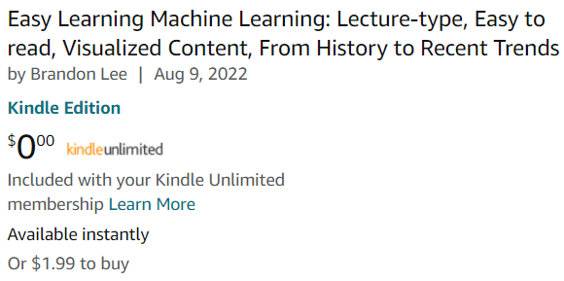

Authored e-Book
For Self-Learners /
Continuing Education
For Researchers in
Medical / ML fields

Slide 38

Thank You for Your Review
Contact: Brandon Lee, slideaiedu@gmail.com, +1-334-922-7703

